Slide 1
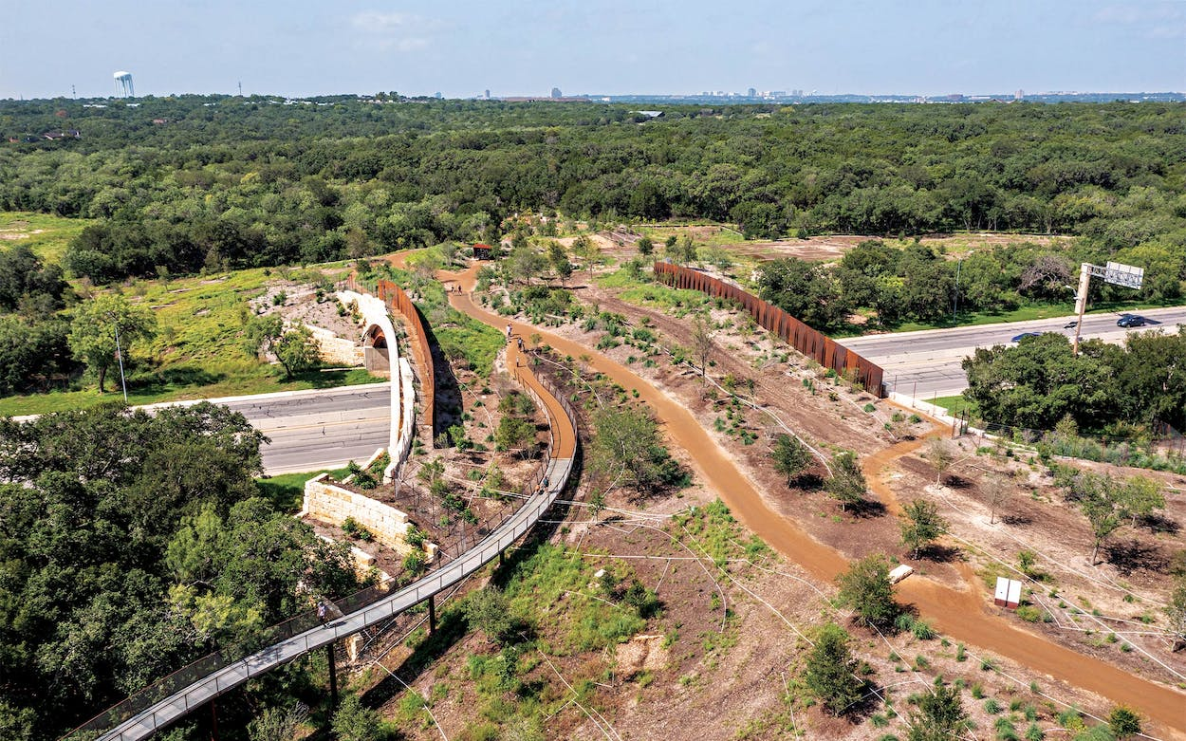
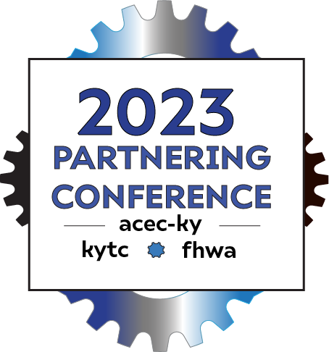
Wildlife Crossings
Presented by: Cassondra Cruikshank
Environmental Biologist II
Created by: Andrew M. Logsdon &
Ecology & Permitting Branch Manager
KYTC
Kevin M. Connor, MS
Senior Environmental Manager
H.W. Lochner, Inc.
The Robert L. B. Tobin Land Bridge in San Antonio.

Slide 2
Wildlife crossings
In the United States alone, there are more than a million automobile accidents per year involving wildlife, racking up more than $8 billion in medical costs and vehicle repairs annually.
According to some estimates, automobile collisions kill more than a million animals every day, making them the leading cause of death for many vertebrate species.
In addition to injury and mortality major roads can subdivide animal populations and further fragment their habitats, making it more difficult to forage for food, find mates and carry on their genetic legacy and avoid in-breeding.
Bridges and tunnels specifically designed for animals and their movements can reduce the environmental impact of highways.
RESEARCH
ABSTRACT
DESIGN

Slide 3
Wildlife crossings
Wildlife crossings can come in many forms, depending on the species involved and the geographic features of the land. The most common forms of wildlife crossing are bridges and overpasses, tunnels, viaducts and culverts.
When successfully implemented, wildlife crossings can greatly reduce the likelihood of collisions, provide a safe corridor for animal transit and help reduce the ecological impact of highways by reconnecting animal habitats.
The concept was first developed in France in the 1950s. It later took off in the Netherlands, where more than 600 crossings have been constructed to protect badgers, elk and other mammals. The Dutch have constructed an overpass for wildlife that spans more than 0.5 miles!
RESEARCH
ABSTRACT
DESIGN

Slide 4
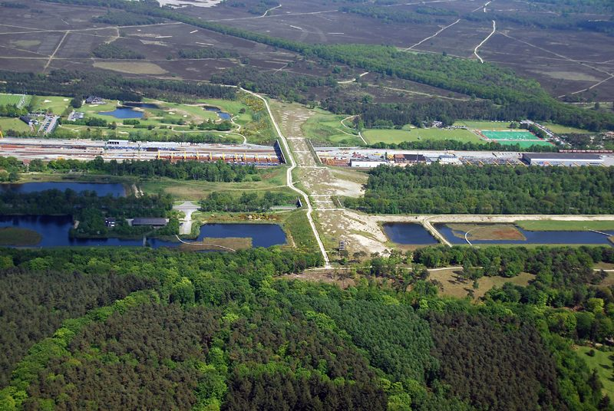
RESEARCH
ABSTRACT
DESIGN
Natuurbrug Zanderij Crailoo in the Netherlands

Slide 5
Wildlife crossings
In Banff National Park in Alberta, Canada. Between 1996 and 2016, 44 structures — six bridges and 38 underpasses — were built for wildlife to traverse the Trans-Canada Highway, the nation's longest road, which bisects the park.
Since its construction park officials documented more than 150,000 crossings by mammals such as elk, moose, black bears, cougar, and grizzly bears.
Recent studies demonstrated that the corridors have specifically helped the grizzly bears maintain a wide enough selection of mates to stabilize their genetic flow.
In addition, the mitigation contributed to an 80% reduction in motor accidents involving wildlife!
RESEARCH
ABSTRACT
DESIGN

Slide 6
SO WHERE IS KENTUCKY???
Answer: We’re working on it!

Slide 7
NEW FUNDS AVAILABLE TO STATE DOTs!!
A grant funding opportunity to study and construct wildlife crossings through the FHWA’s Wildlife Crossing Pilot Program (WCPP) went live in April of this year.
Applications were due to FHWA by August 1!
Kentucky Transportation Cabinet, with the help of consultants, worked quickly to get a proposal together to receive some funds through the first round of selections later this year.
Essentially started from scratch but in 3 months built quite an impressive team of stakeholders.
RESEARCH
ABSTRACT
DESIGN

Slide 8
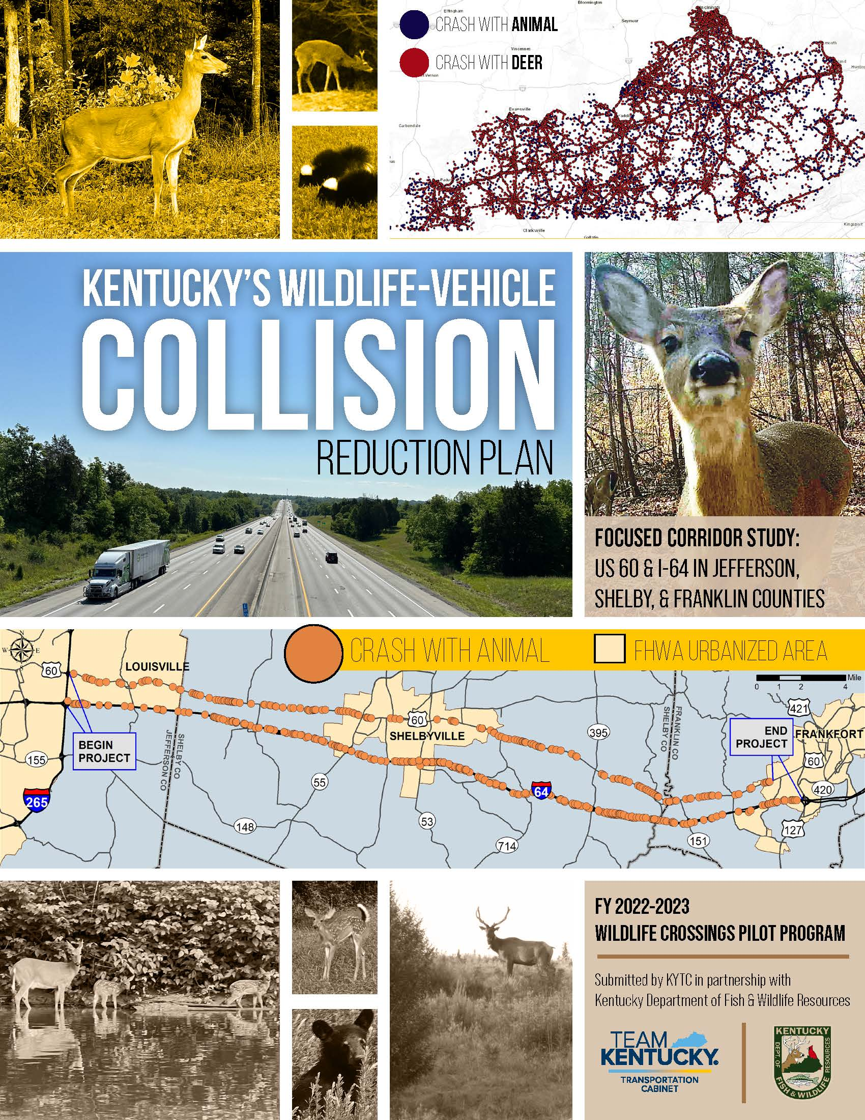
KENTUCKY’s
WCPP GRANT
PROPOSAL
AWARDED!

Slide 9
What will we study
Applying for non-construction funds initially to start the research and data collection phase.
KYTC intends to coordinate with multiple agencies and environmental experts to develop a process and identify strategies that will provide substantial safety benefits and advance safe, efficient transportation, in an environmentally sustainable manner.
If funded KYTC will implement a planning process that has two compatible and beneficial scopes—a Statewide plan and a focused pilot corridor study to identify potential solutions that could be implemented throughout the state.
RESEARCH
ABSTRACT
DESIGN

Slide 10
What will we study
According to the State Farm Insurance Company’s 2022 report on animal collisions, the likelihood of an animal involved claim in Kentucky is 1 in 85. Kentucky ranks 19th in the nation for reported animal collisions.
KYTC will start with a comprehensive assessment of the existing road network and its impact on wildlife populations will be conducted. This evaluation will identify key areas where road expansions and high traffic volumes intersect with important wildlife habitats and migration routes.
The focused corridor study area includes segments of I-64 and US 60 between Frankfort, Kentucky (the State Capital) and the Jefferson County/Louisville Metro area (the most populous area in the state) and runs through parts of Jefferson, Shelby, and Franklin Counties.
RESEARCH
ABSTRACT
DESIGN

Slide 11
Why That specific Corridor?

Slide 12
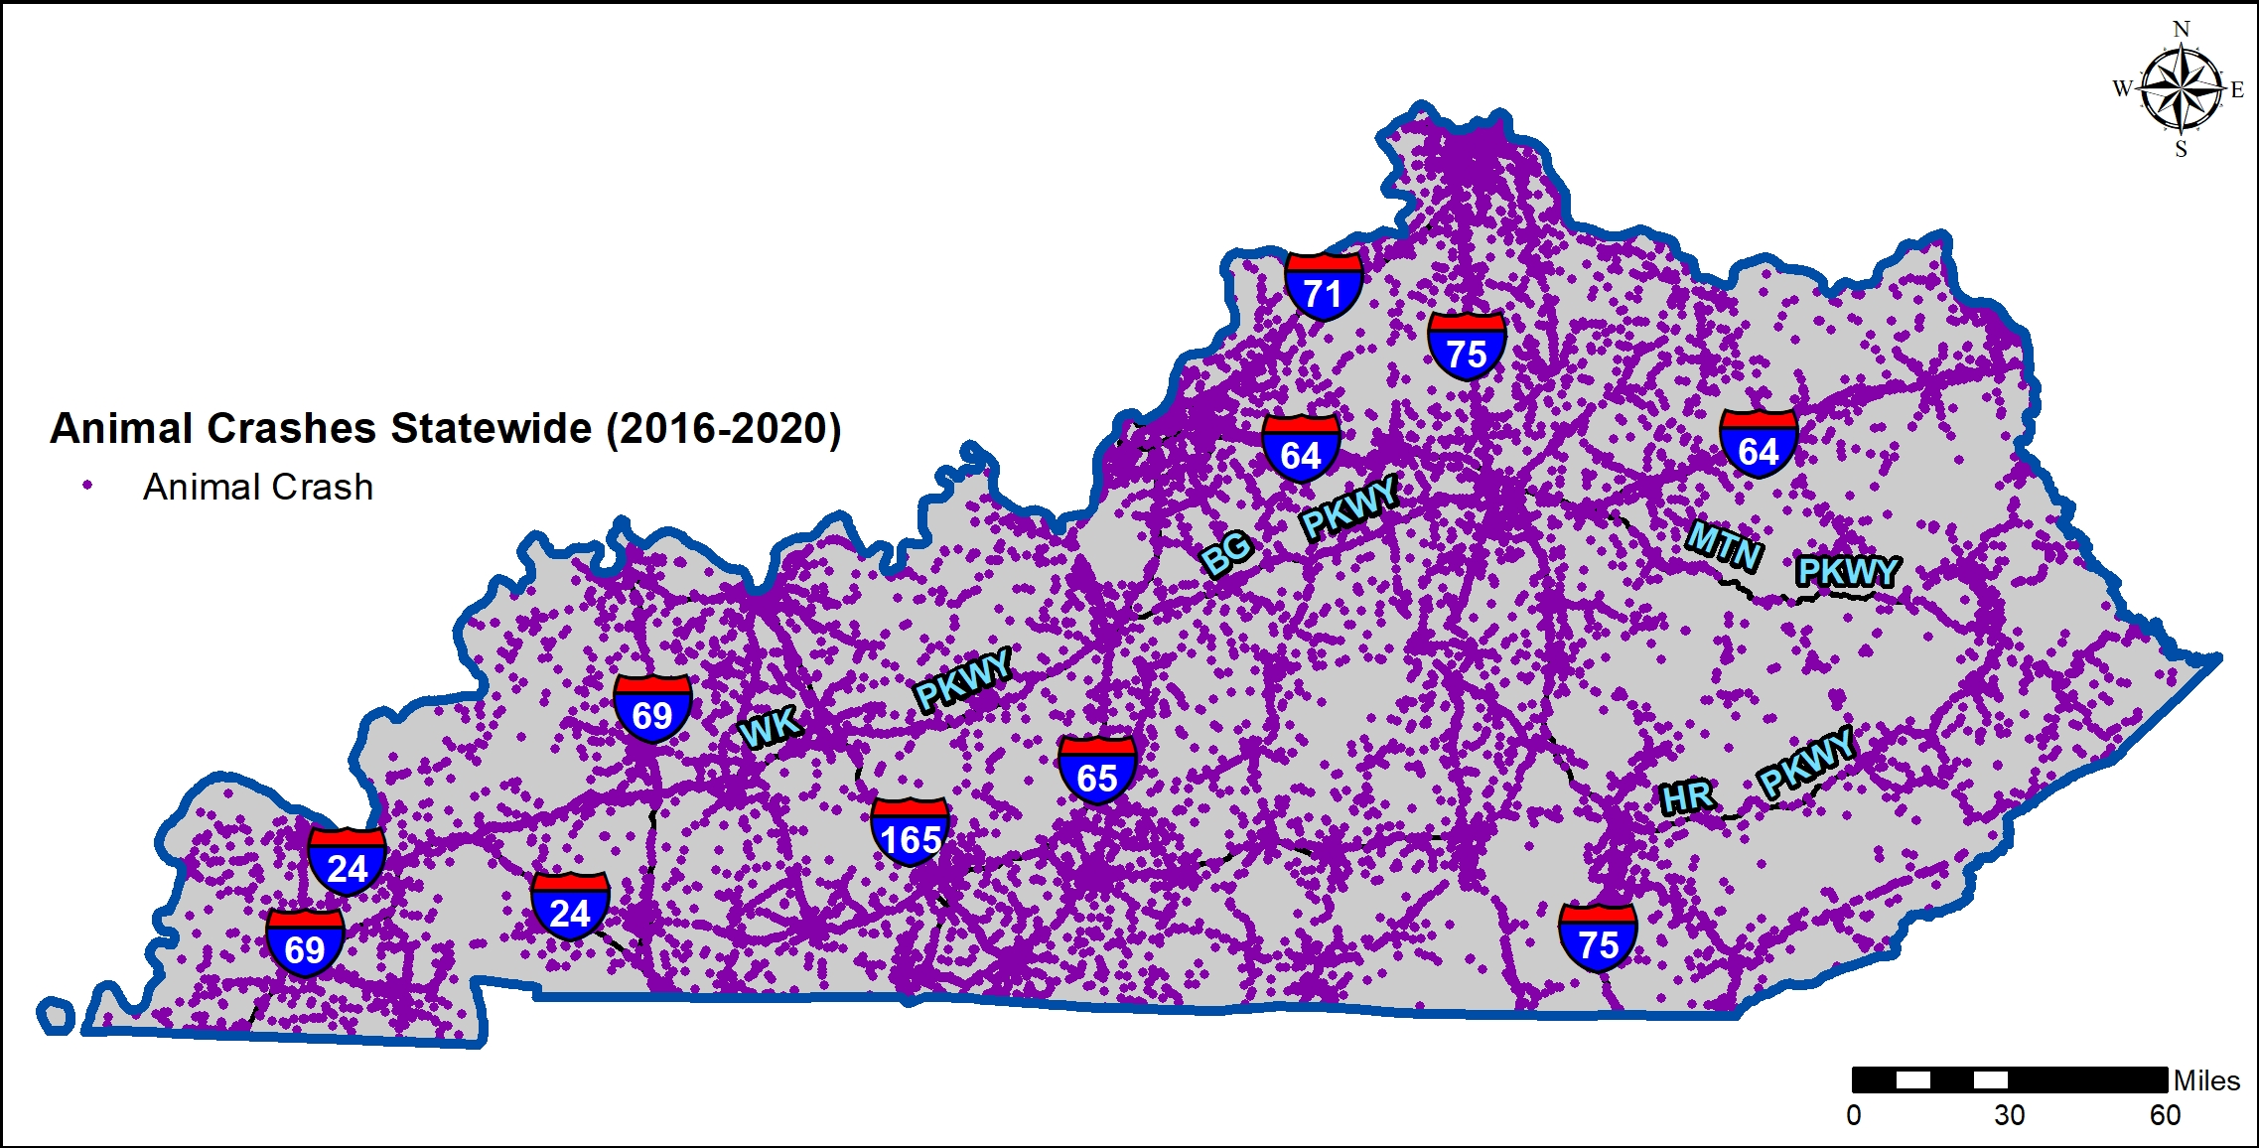
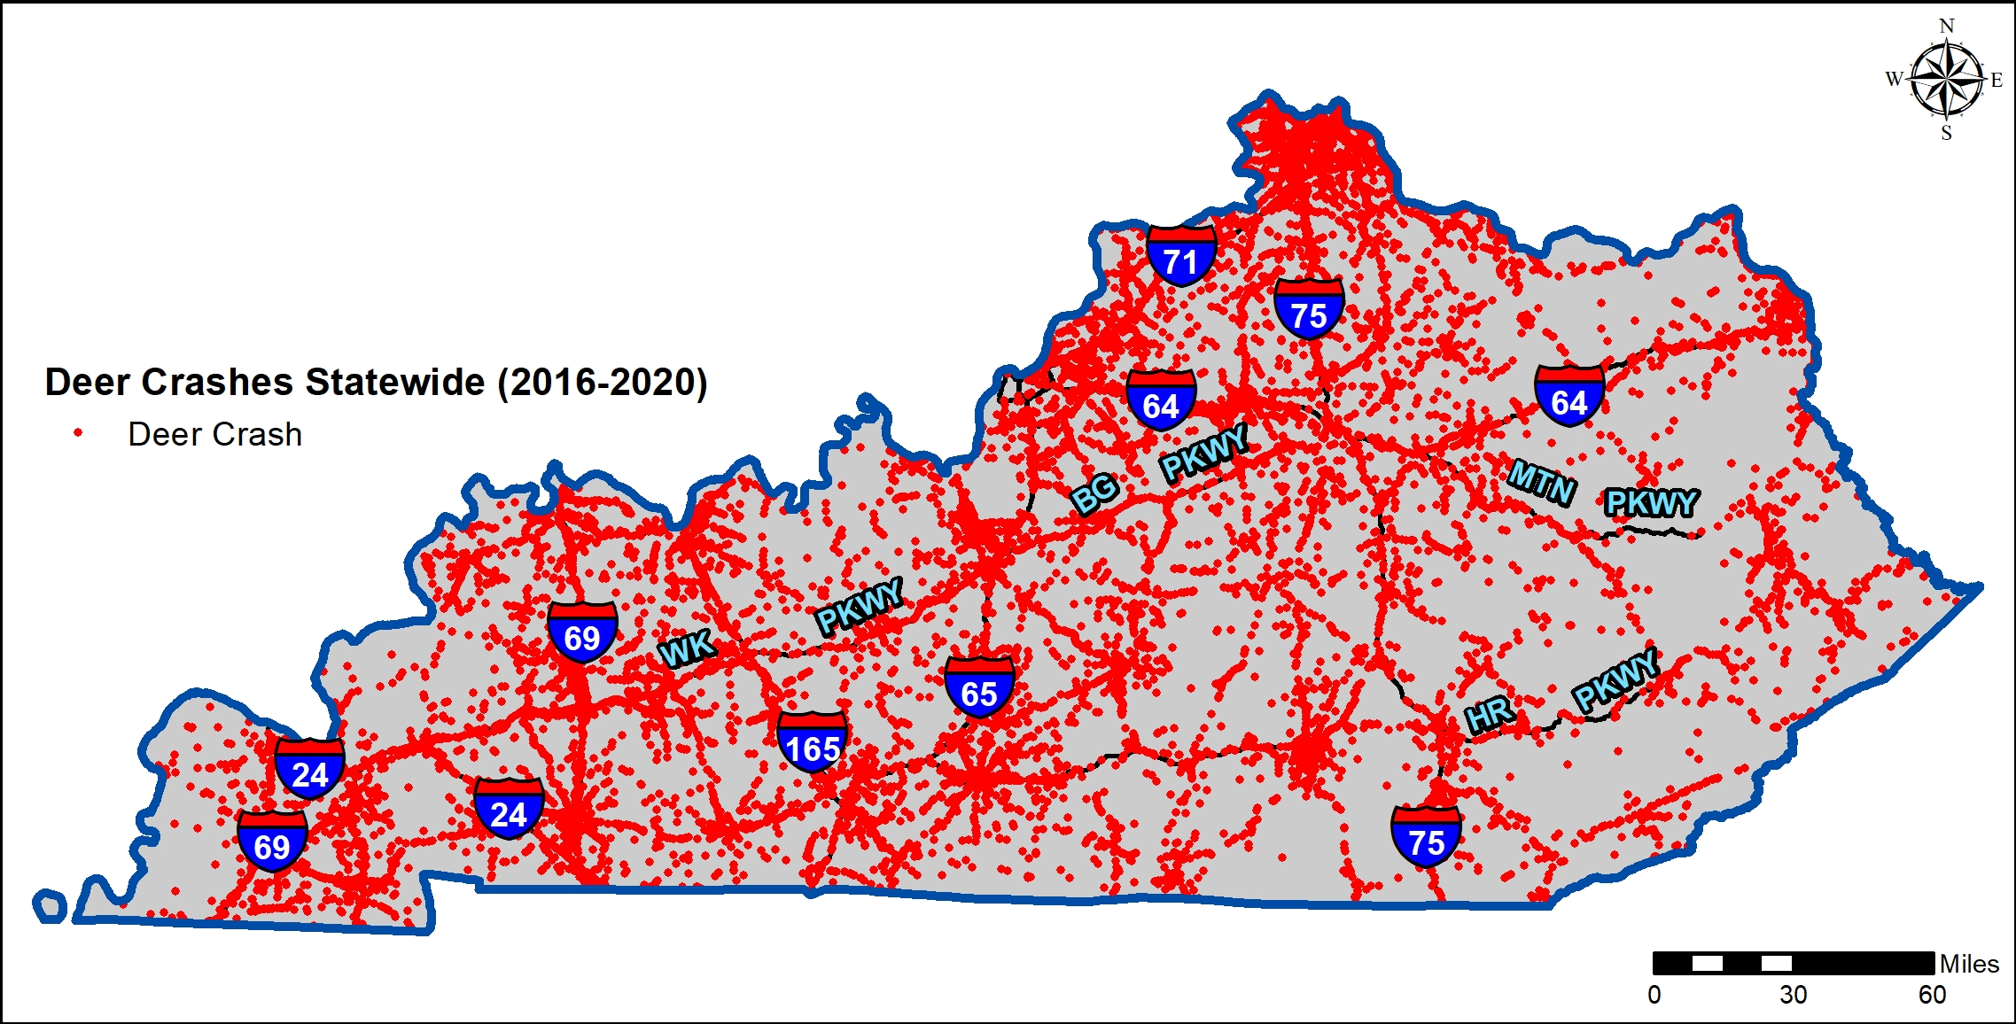
Why That specific Corridor?

Slide 13
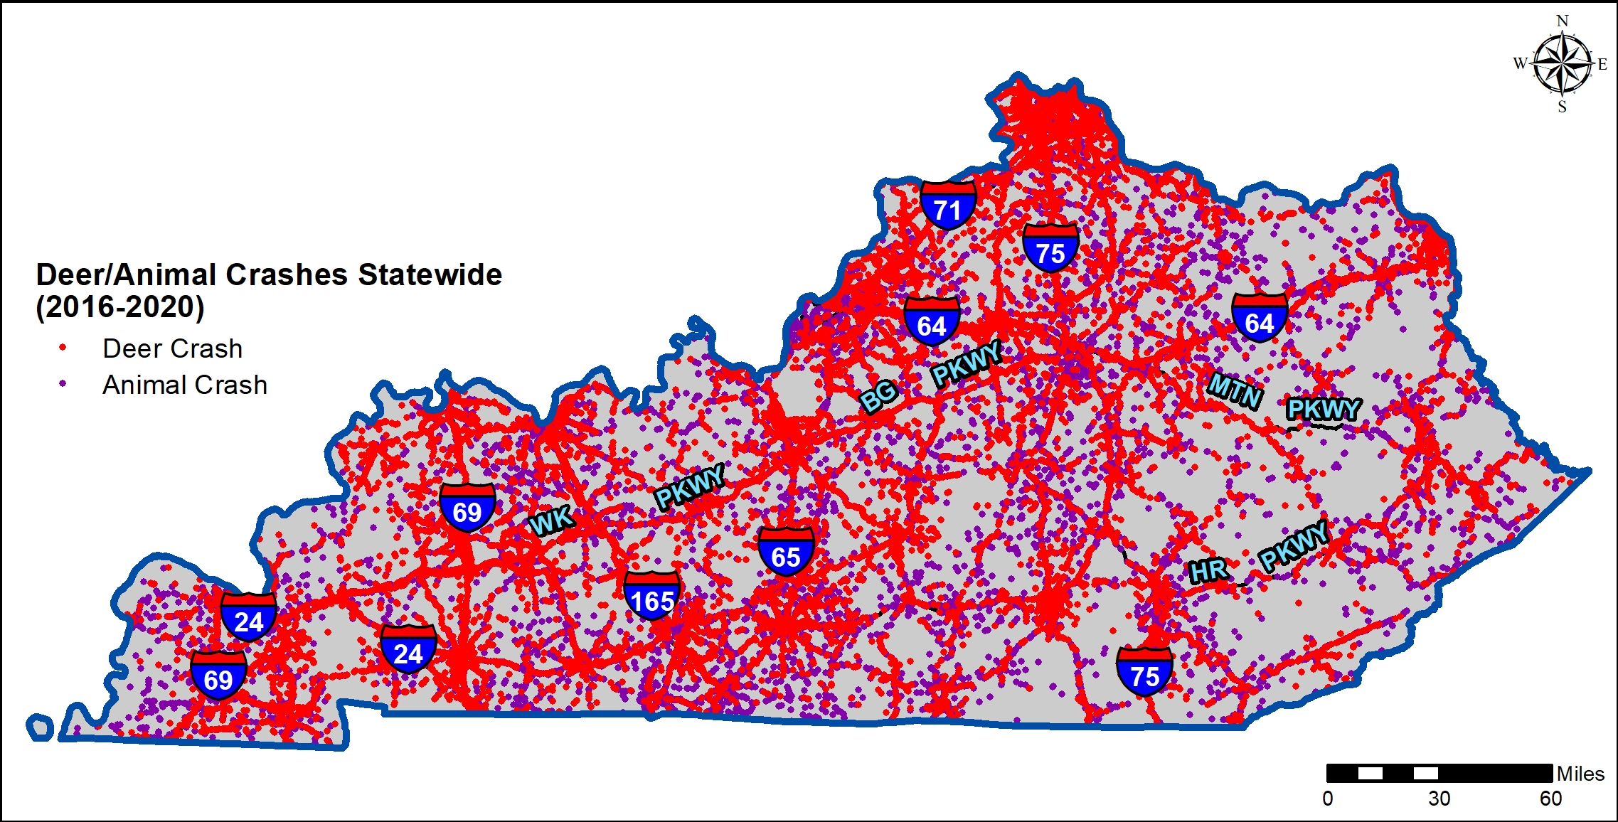

Slide 14
Who will we work with?
KYTC will have a “strategic partnership” with the Kentucky Department of Fish and Wildlife Resources (KDFWR) during the implementation of the grant and planning process.
Some more supporting agencies and non-governmental groups include US Fish and Wildlife Service-KY Field Office, Kentucky Conservation Committee (Bluegrass Conservancy, Kentucky Natural Lands Trust, American Farmland Trust, and The Nature Conservancy of Kentucky), The Kentucky Sportsman Caucus.
Our Commonwealth neighbor, Virginia, is about 5-7 years ahead of us in this process has reached out and is willing to assist in Kentucky’s effort. They have completed a successful WVC planning effort and are moving into the planning and construction phase soon. The hope is to one day team up on a crossing project along our border near Pine Mountain and US 460.
Sixty seven elected officials throughout the state have prepared letters of support from their offices to FHWA in an effort to help KYTC be awarded funding.
RESEARCH
ABSTRACT
DESIGN

Slide 15
PLEASE STAY TUNED

